Slide 1
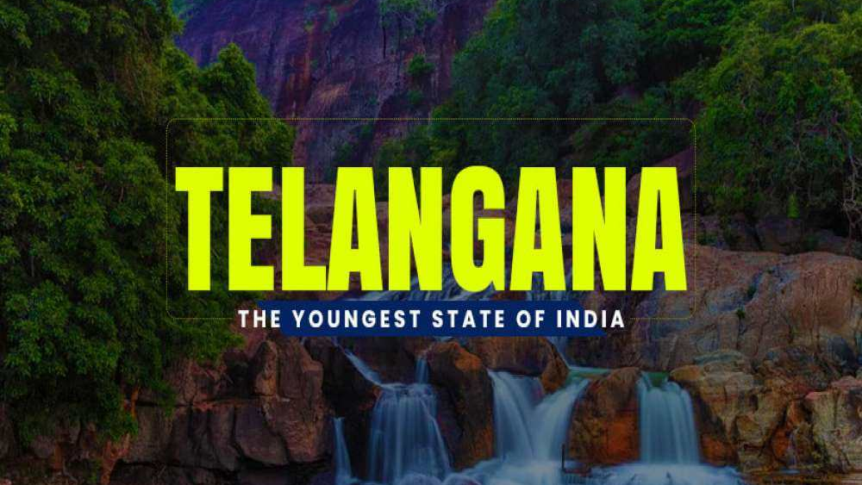
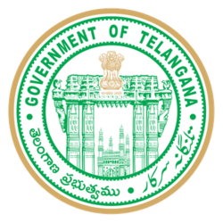

Tourism Challenge by Codebasics

Slide 2
Objectives
📌Telangana is one of India’s leading states and has published its tourism data under its open data policy.
📌 Peter Pandey who is a data enthusiast saw this an opportunity to expand its skills.
📌 From his analysis he provides recommendations to Telangana government which can be used to increase their revenue.
📌 So here I am working as a Peter Pandey assistant who try to provide insights from data to Peter Pandey and help Peter Pandey to expand his skills and provide recommendations to Telangana.

Slide 3
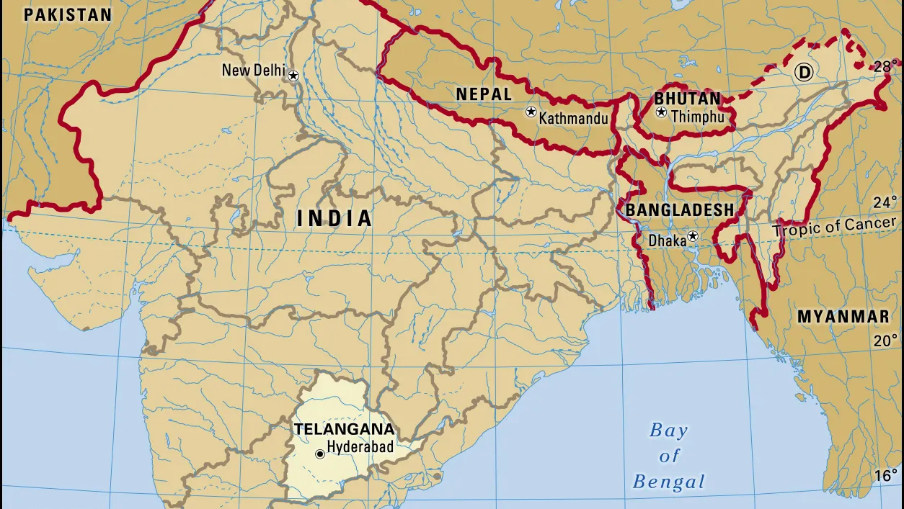
About Telangana
Telangana is a constituent state of south-central India. It is bordered by the states of Maharashtra to the north, Chhattisgarh and Odisha to the northeast, Andhra Pradesh to the southeast and south, and Karnataka to the west.

Slide 4
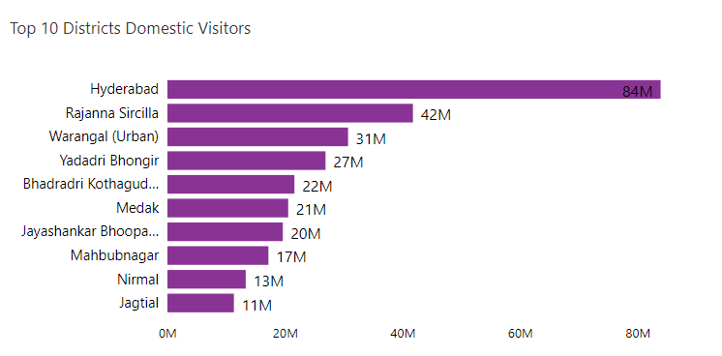



Domestic Tourism
📌 Total Number of visitors which are visited in Telangana from 2016-2019 are around 357 Million.
📌 If we want to see domestic stats then around 356 Million visitors are domestic.
📌 Around 1 Million visitors are from foreign Countries.
📌According to our Analysis data, we see that Hyderabad is the most visited city with about 84 million visitors.
📌 Hyderabad is one of the IT Hub of India, also It has so many ancient monuments like Charminar.
📌 Rajanna Sircilla is famous for Vemulwada temple which was Dedicated to Lord Shiva.
📌 Thousands of worshippers comes on Shirvratri to worship Lord Shiva in this temple.
📌Warangal is famous for its Warangal fort which is spread over a radius of 19 km. It is mostly famous for its graceful and finitely carved arches and pillars.

Slide 5
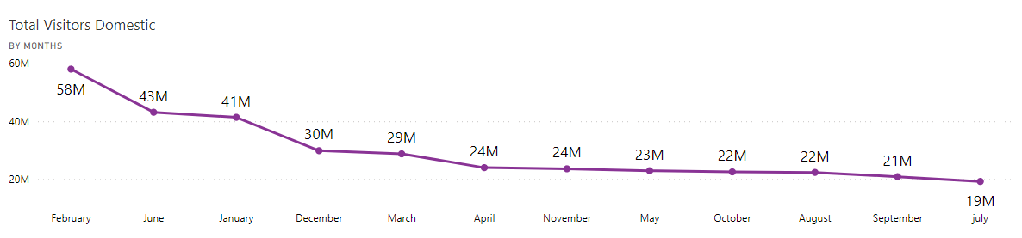


Domestic Tourism
📌 Total Number of visitors which are visited in Telangana from 2016-2019 are around 357 Million.
📌 If we want to see domestic stats then around 356 Million visitors are domestic.
📌 Around 1 Million visitors are from foreign Countries.
📌From above graph, we conclude that starting months of year and summer months are the peak months for visitors in a year.
📌Starting months are at peak because of new year plus festivals like Pongal, Maha Shiv Ratri etc.
📌Summer Months are at peak because of Summer holidays, and Telangana has lots of tourist places for adults as well as for Childrens.

Slide 6
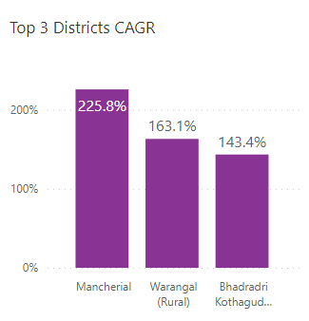



Compound Annual Growth Rate
📌 The overall CAGR is negative which tells us that the annual growth from 16-19 is declining.
📌Maximum CAGR is of Mancherial district with a growth of above 200 % annually.
📌Minimum CAGR is of Karimnagar district with a decline of 79% annually.
📌Mancherial district seen a growth of more than 200% from 2016-2019,
📌 Govt. of Telangana developed some new Tourist attractions like Gudem Wildlife Sanctuary, Kollapur Bird Sanctuary in Mancherial.
📌 Warangal (Rural) has the best tourist attractions like a thousand pillar temple, Warangal Fort, Ramappa Temple etc., because of which it has seen an annual growth of 160 % from 2016-19.
📌 Bhadradri Kothagudem has a tourist attraction of Papikondalu Waterfalls plus Kolleru lake, so that the nature lovers will enjoy here.
📌Bhadradri has introduced a project named “Vastratan” to promote textile tourism by establishing a craft town.

Slide 7
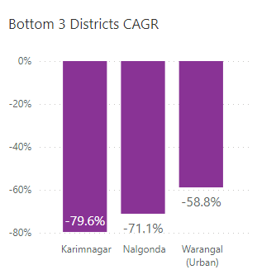

Compound Annual Growth Rate
📌 The overall CAGR is negative which tells us that the annual growth from 16-19 is declining.
📌Maximum CAGR is of Mancherial district with a growth of above 200 % annually.
📌Minimum CAGR is of Karimnagar district with a decline of 79% annually.
📌Karimnagar district seen a decline of around 79% from 2016-2019,
📌 Karimnagar has a Poor Infrastructure, it has only one National Highway -163,
plus the district has also limited Railway Stations.
📌 Nalgonda district does not have many tourist attractions,
📌 The few Attractions that do exist are not well maintained like Nalgonda Fort,
which is in a state of disrepair and not well maintained.
📌 Nalgonda district has a high crime rate; this makes tourist unsafe and
discourages them from visiting.

Slide 8
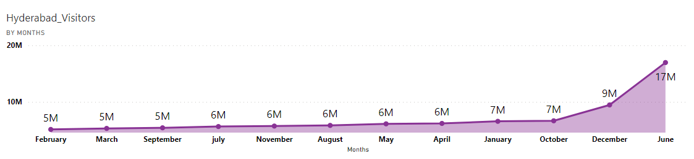



Hyderabad Analysis
📌 Total Number of visitors which are visited in Telangana from 2016-2019 are around 357 Million.
📌 If we want to see domestic stats then around 84 Million visitors are domestic in Hyderabad.
📌 Around 1 Million visitors are from foreign Countries which visited Hyderabad.
📌Above graph tells us that, during summer month June there was a peak of number of tourist in Hyderabad, because of summer Holidays of children and some Adults.
📌There was a peak of number of tourist in last months of a year because of winter and Diwali holidays, and Hyderabad arts festivals also organized in this months.
📌Another reason is that Hyderabad has a warmer climate, so winter season is the best time to visit Hyderabad.

Slide 9
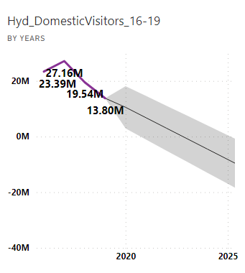
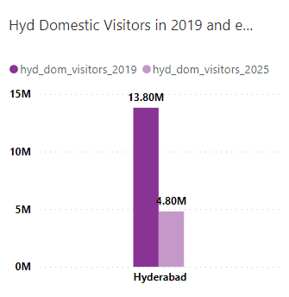
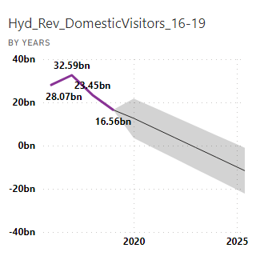
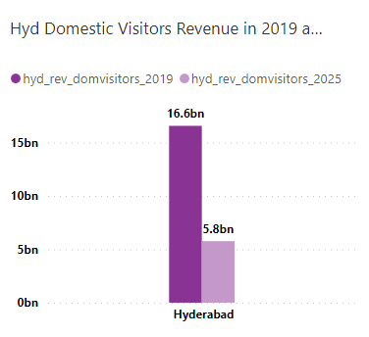
Hyderabad Analysis
Domestic Tourist 2016-2019
📌Here the graph shows that number of visitors in Hyderabad is gradually decreasing from year 2018,
📌 Mainly domestic visitors are reducing year by year in Hyderabad, in 2018 total domestic visitors are around 19.54 million, but in 2019 they are declined to up to 13.8 million, a decline of 29%.
📌 If we forecast number of visitors according to data from 2016-2019, in 2025 only 4.8 million people will visit Hyderabad, which is a decline of around 65% from 2019 visitors.
📌But this is a prediction, we can’t predict the future. In case the government efforts for increasing the number of visitors can also affect the prediction.
📌From the graph we found that, Revenue of domestic visitors is declining from the year 2018, because of gradually declining of number of visitors.
📌Due to decline of number of domestic visitors, the revenue generated from visitors is also declining , like in 2017 the revenue generated was around 32.59 billion, but in 2018 the revenue was around 23.45 billion, a decline of 29 %.
📌Here we are assuming that avg spend per domestic visitor was around 1200 Rs.
📌 If we forecast the revenue for 2025 from previous year data, we got the estimated revenue around 5.8 billion Rs. , if we compare it with 2019 the revenue was 16.6 billion, a decline of 65%.

Slide 10
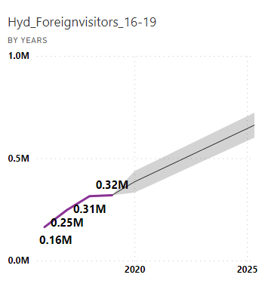
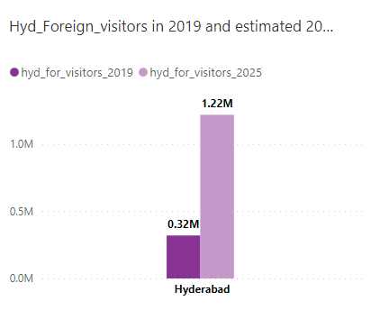
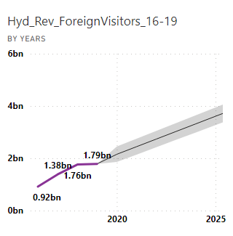
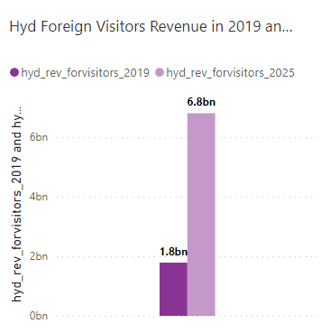
Hyderabad Analysis
Foreign Tourist 2016-2019
📌Here the graph shows that number of visitors in Hyderabad is gradually increasing yearly,
📌 Mainly foreign visitors are increasing year by year in Hyderabad, in 2016 total foreign visitors are around 0.16 million, but in 2019 they are increased up to 0.32 million, an increment of 100% which means the visitors are just doubled.
📌 If we forecast number of visitors according to data from 2016-2019, in 2025 around 1.2 million people will visit Hyderabad, which is an increment of around more than 200% from 2019 visitors.
📌But this is a prediction, we can’t predict the future. In case there is any natural disaster or any policies by govt. which was not in favor of foreign tourist then there may be low values than what we predict.
📌From the graph we found that, Revenue of foreign visitors is an inclined slope because of gradually increase of number of visitors.
📌Due to increase of number of foreign visitors, the revenue generated from visitors is also growing , like in 2016 the revenue generated was around 0.92 billion, but in 2019 the revenue was around 1.79 billion, which is doubled.
📌Here we are assuming that avg spend per foreign visitor was around 5600 Rs.
📌 If we forecast the revenue for 2025 from previous year data, we got the estimated revenue around 6.8 billion Rs. , if we compare it with 2019 the revenue was 1.79 billion, an incline of above 200%.

Slide 11
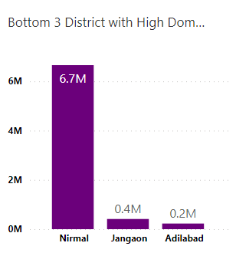
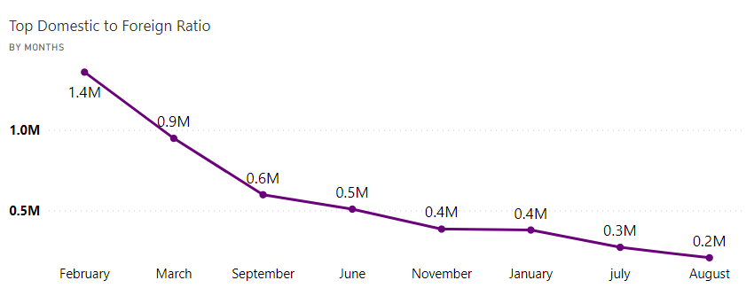
Domestic to Foreign Ratio
📌 Here High refers to, district which have high difference between number of domestic and foreign visitors, which is not good.
High D to F Ratio 2016-2019
📌 Domestic to foreign ratio tells us that how many domestic visitors visited per foreign visitors, which helps us to see the difference between domestic and foreign figures.
📌Nirmal district has 6.7 millions domestic visitor per foreign visitor.
📌From Graph, we see that Feb has more domestic visitors as compared to foreign visitors.
📌Months like sept and Jan, there is less difference between domestic and foreign tourist.
📌July and August months are the months in which foreign visitors visited more as compared to other months.

Slide 12
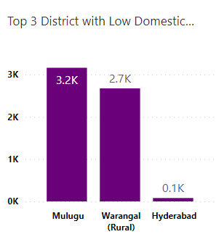
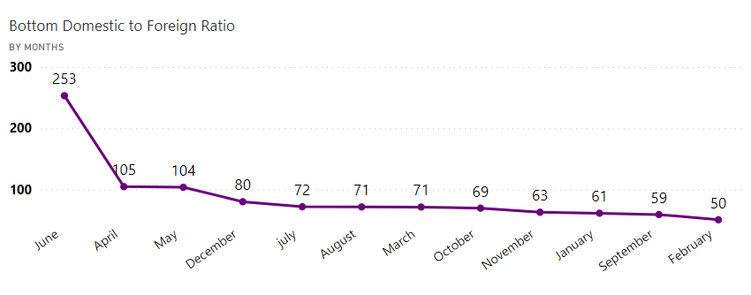
Domestic to Foreign Ratio
📌 Here low refers to, district which have low difference between number of domestic and foreign visitors, which is good.
Low D to F Ratio 2016-2019
📌 Domestic to foreign ratio tells us that how many domestic visitors visited per foreign visitors, which helps us to see the difference between domestic and foreign figures.
📌Hyderabad district has less than 100 domestic visitor per foreign visitor.
📌From Graph, we see that June has higher difference between domestic and foreign visitors.
📌Months like sept and Jan, there is less difference between domestic and foreign tourist.
📌Feb is the month where there is minimum difference between domestic and foreign visitors.

Slide 13
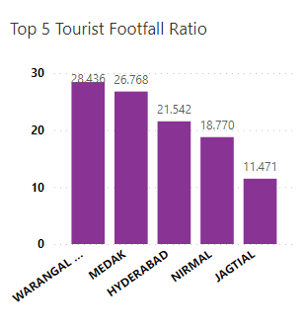
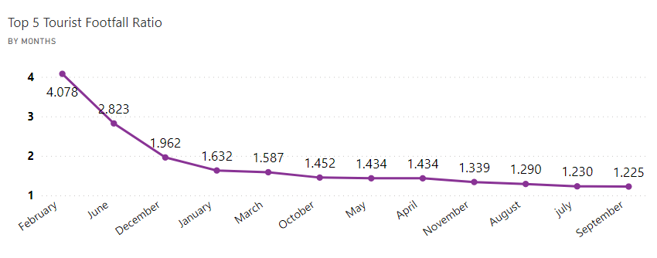
Footfall Ratio
📌 Here top refers to, district which have low diff. between number of visitors, and number of population in that district, which is good.
Top Footfall Ratio 2016-2019
📌Footfall ratio is the ratio of total number of visitors divided by Total residents' population in the given year.
📌Warangal has the highest footfall ratio, which gives us idea that it has high tourism activity.
📌From Graph, we see that Feb has higher footfall ratio between visitors and population.
📌Middle months like may and April have a constant footfall ratio.
📌Sept month has a very low footfall ratio which mainly because of rainy season.
*Note :- The Population data is taken from 2011 Census from Govt. of India

Slide 14
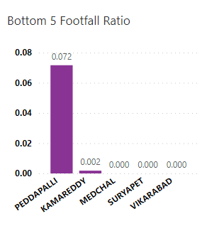
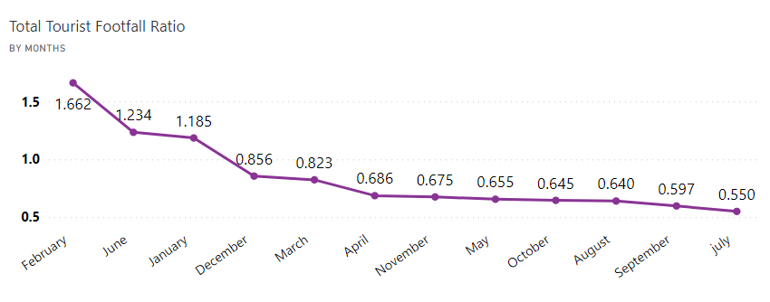
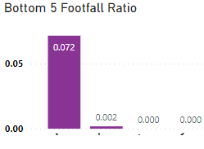
Footfall Ratio
📌 Here bottom refers to, district which have high diff. between number of visitors, and number of population in that district, which is bad.
Bottom Footfall Ratio 2016-2019
📌Footfall ratio is the ratio of total number of visitors divided by Total residents' population in the given year.
📌Vikarabad, Suryapet etc., has the lowest footfall ratio, which gives us idea that it has low tourism activity.
📌From Graph, we see that Feb has higher footfall ratio between visitors and population.
📌Middle months like may and April have a constant footfall ratio.
📌Sep, July month has a very low footfall ratio which mainly because of rainy season.
*Note :- The Population data is taken from 2011 Census from Govt. of India

Slide 15
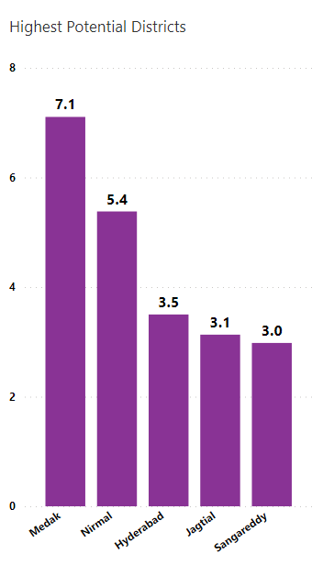
Highest Potential Districts
📌Medak:
1). According to stats Medak has highest potential to grow, Medak is mainly famous for Medak Church, Medak Fort, Huge number of ancient temples and Bathukamma a famous festival of Medak.
💡 Suggestion:
Government can promote Bathukamma festival using different travel influencers, and they can hire some local bodies which tells tourist about the history of the festival and faith of peoples in Goddess Maha Gauri.
📌Nirmal:
1). Nirmal is well known for its wooden toys. This city is also known as city of arts and crafts.
💡 Suggestion:
Government can plan different exhibitions for the wooden paintings which are created by local bodies and organize some vents in which they provide free toys to the tourist and promote the arts of local peoples to the tourists.
📌Hyderabad:
1). Hyderabad has many tourist places to visit, such as palaces, forts and lakes. It is also famous for its rich culture, buzzing markets and delicious cuisine.
💡 Suggestion:
Government can take an initiative to allow tourist camping in Nehru Zoo Park, they can assign some tour guides or security persons which live with tourist camping in that park so that tourist will also connect with wildlife.
📌Jagtial:
1). Jagtial is famous for its temples and forts.
💡 Suggestion:
Government can organize cultural events in Sri Anjaneya Temple, in which they organize Dramatic Folk of this temple which includes history of this temple and how it is made.
📌Sangareddy:
1). Sangareddy offers something for everyone, from ancient monuments to modern shopping malls.
💡 Suggestion:
Government can plan to educate tourist about Singoor Project Dam, which was built in 1989. They educate tourist that how this dam helps farmer in their agriculture and also how this dam generates electricity.

Slide 16
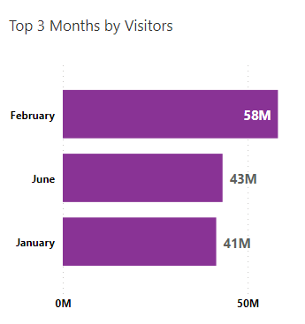
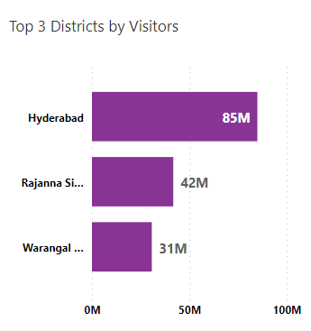
Cultural / Corporate Events to Boost Tourism
✨ Kind of Events :
📌 Dramatic Folks and Cultural Events:
1). Government can organize different dramatic folks, which includes history of temples, Places, Forts etc.
2). Government can plan to organize different dance forms, musical events which are famous in that area.
📌Exhibitions:
1). Local corporation can introduce different exhibitions of famous things of that area.
2). They also organize small competitions for that things and the winners will get that things as a prizes, so that tourist will also enjoy that competitions.
✨ Months:
📌 Peak Time:
1). According to our analysis, we found that January, February, June are the most peak months of visitors.
2). Mainly June is the month of summer holidays, in which government can organize summer markets which contains promotions of local products also outdoor music concerts.
3). Mainly January and February have the Pongal festival which is used to celebrate the harvesting of crops in farms, so that time the tourist appearance is at peak, it is good time for organizing many cultural events dedicated to Pongal.
✨ Districts:
1). Mainly there are 3 districts which have most of visitors which are Hyderabad, Rajanna Sircilla, Warangal (Urban).
2). Hyderabad is the capital of Telangana, and it has lots of tourist places including ancient monuments, temples, markets etc., because of that it has high number of tourist.
3). Rajanna Sircilla has a famous temple Vemulwada which was dedicated to Lord Shiva, thousands of worshippers come at the time of Shivaratri which the month of February for worshipping Lord Shiva.

Slide 17
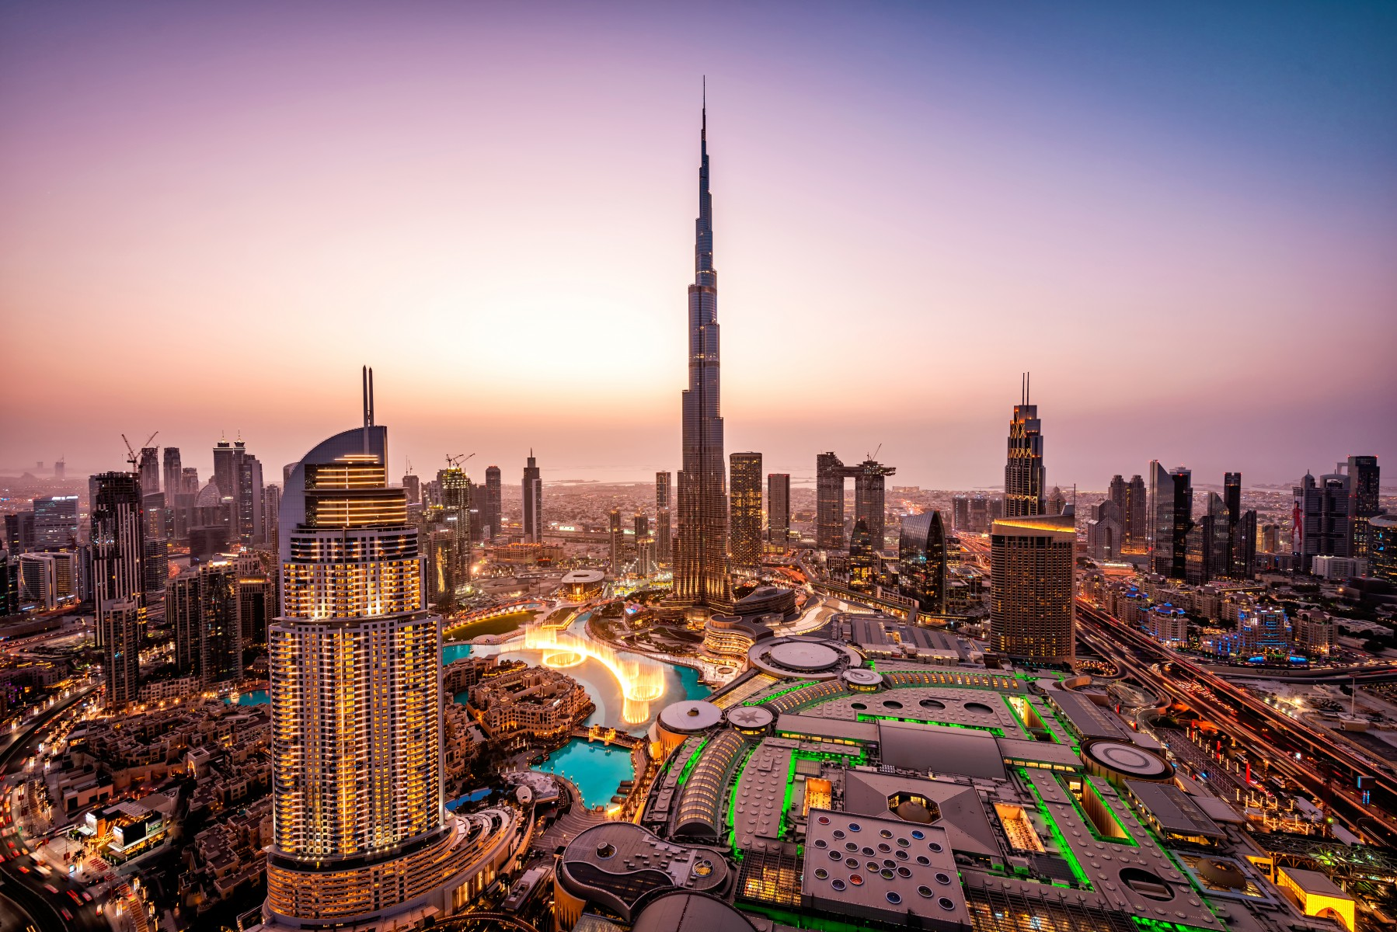
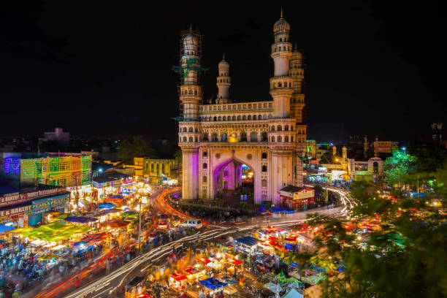
Dubai Vs Hyderabad
✨ Dubai :
📌 Infrastructure:
1). Dubai has world – class infrastructure with moder airports, powerful transportation network, Luxurious Hotels.
2). Dubai has invested heavily in infrastructure this has made it a transportation hub and a more attractive destinations for tourists.
📌Business:
1). Dubai has made so many business-friendly policies and offering tax breaks which made it a global business hub and a destination for business tourism.
✨ Dubai Vs Hyderabad:
1). Compared to Dubai, Hyderabad has a long way to go in infrastructure development, government needs to invest more in infrastructure developments.
2). A business enthusiast will prefer Dubai as compared to Hyderabad because Dubai has more friendly policies for business and low tax, but in Hyderabad Taxes are high for a business.
3). Hyderabad has a rich variety of culture and diversity as compared to Dubai, it has a local festivals and ancient monuments which attracts tourist to come to Hyderabad.
✨ Hyderabad:
📌 Infrastructure:
1). Hyderabad made a significant progress in infrastructure development by building airports and transportation systems.
2). The city metro rail system has improved the connectivity within the city
📌 Business:
1). Hyderabad has just started to create a business-friendly environment by trying to promote business enthusiasts to invest in city so that Hyderabad can also become a business hub.

Slide 18
Suggestions
Investing in Infrastructure
Business and Trade
Cultural Events
📌 Telangana need to invest in its infrastructure by building modern airports, transportation networks, railways, technology parks.
📌 Telangana needs to create a business-friendly environment, by offering tax breaks, making some policies which favors business to invest in Telangana, so that it will become a destination of business tourism.
📌 Telangana can actively attract and host many international conferences, Hyderabad is an IT Hub so it will take this as an advantage and host many technology specific conferences or exhibitions.
📌 Govt. needs to plan some cultural events in which they organize dramatic folks which tells about history of that area. Also, they hire some local guides which tells tourist about the rituals festivals which are celebrated in that area, and they encourage tourist to also take part in that festivals.
📌 In month of October, there was a festival Bathukamma, which was celebrated for 9 days dedicating to Goddess Maha Gauri. This festival can be promoted by governments, and they encourage tourist with the help of tour guides that take part in this festival for 9 days.
📌Government can promote tourism with the help of Social media influencers and celebrities which promote Telangana and tell the audience that visit Telangana once, so that tourist can experience the rich and ancient culture of Telangana.
Promote Tourism

Slide 19


Resume Project Challenge by Codebasics
Hemanand Vadivel as Tony Sharma
Dhaval Patel as Peter Pandey
Thank You ^ Infinite

